Slide 1

CHURN PREDICTION PROJECT

Slide 2
Agenda
1 | 2 | 3 | 4
Objectif and Description project | Data Audit and Exploration | Data visualization | Training and Machine models

Slide 3
Agenda
1 | 2 | 3 | 4
Objectif and Description project | Data Audit and Exploration | Data visualization | Training and Machine models

Slide 4
Objectif and Description project
The objective of this project aims to predict whether a customer will drop their contract with a telecommunications company
Visualization of metrics reliable with churn of customer and their profile
selected Algorithms of Machine learning

Slide 5
Agenda
1 | 2 | 3 | 4
Objectif and Description project | Data Audit and Exploration | Data visualization | Training and Machine models

Slide 6
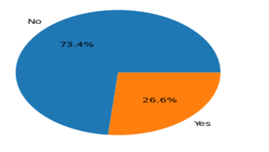
Data Audit and Exploration
Audit Data
1 column quantitative contains String value
Detection of string value in this column and evaluate the number of String value => 10 values
Data Cleaning
Drop those string values not impact our Dataset
Data Analysis
Visualization profile of customer churn
Analysis of correlations between features and target
Import main tools for study
Import the Dataset into a data frame using pandas and display it => 5985 x 21
Take look how many null value and type of columns => 5 columns quantitative and 16 columns qualitative
Rate churn

Slide 7
Agenda
1 | 2 | 3 | 4
Objectif and Description project | Data Audit and Exploration | Data visualization | Training and Machine models

Slide 8
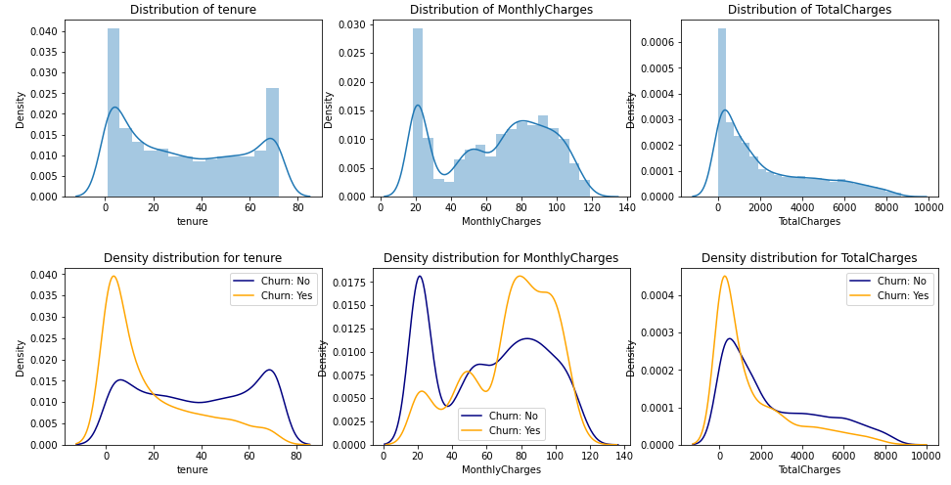
Data visualization
Relation between churn and variable quantitative
Recent clients are more likely to churn
Clients with higher Monthly Charges churn if it exceeds 60
*tenure = start of contract

Slide 9
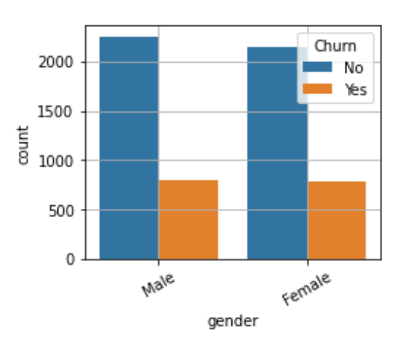
Data exploration
Analysis and customer profile
Profile of the customer churned
Junior citizen without partner and independent.
Those subscribed for "Phone Internet" month-to-month contract without extra internet services (online security, online backup, device protection and technical support).
They usually chosen the electronic invoice (i.e. Paperless Billing) with electronic check payment method.
They used streaming services (TV and/or Movies) does not seem to affect their contract termination
Gender is stable, and so this variable can be dropped from our dataset without impact on the target .
Notes:
The analysis of categorical variables indicate the gender is stable, and so this variable can be dropped from our dataset without impact on the target .
Others variables, unrelated but they should be considered in the model training evaluation
"junior" citizen without partner and independent.
Those subscribed for "Phone Internet" month-to-month contract without extra internet services (online security, online backup, device protection and technical support).
They usually chosen the electronic invoice (i.e. Paperless Billing) with electronic check payment method.
they used streaming services (TV and/or Movies) does not seem to affect their contract termination

Slide 10
Agenda
1 | 2 | 3 | 4
Objectif and Description project | Data Audit and Exploration | Data visualization | Training and Machine models

Slide 11
Training and Machine models
MODEL TRAINING EVALUATION
9 classifier algorithms have been selected.
According to the results, it will provide us a baseline to go deeper inside the analysis and try to further improve the results. Evaluation of dataset before hyperparameter tuning
Kneighbors Classifier
Linear SVC
DecisionTree Classifier
Random Forest Classifier
AdaBoostClassifier
GradientBoostingClassifier
Logistic Regression
Support Vector
Gaussian Naive Bayes
.

Slide 12
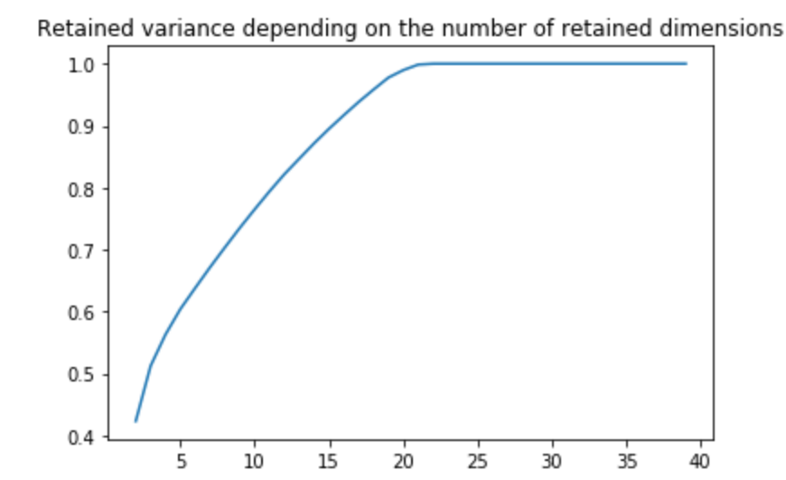
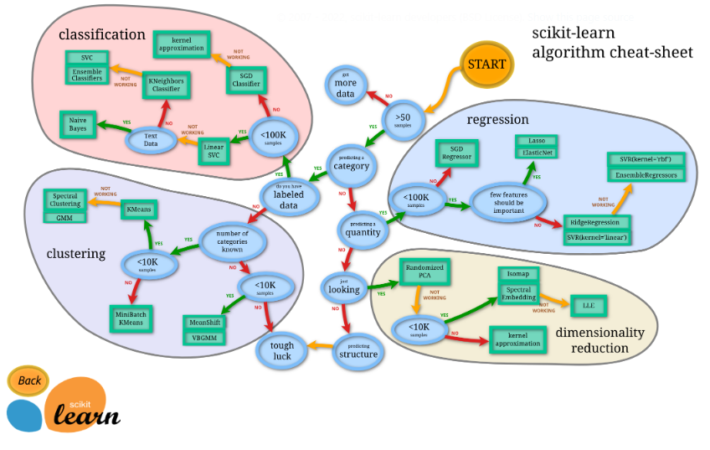
Training and Machine models
Wrong attempts
No combination works.
we have several value of components unfortunately we still have a score lower than 50%
Randomized PCA
According to Scikit -learn Randomized PCA is not suitable for classification

Slide 13
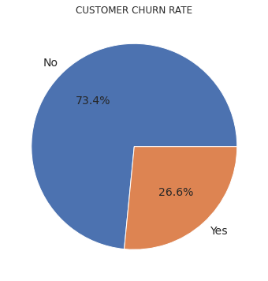
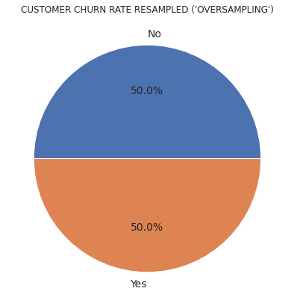
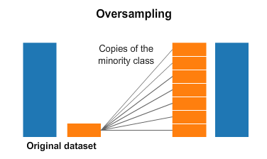
Dataset Balancing
It is indicated that most models trained on unbalanced data could have a bias towards predicting the larger class and, in many cases, may ignore the smaller class altogether.
Method #1 : Oversampling Approach
Random oversampling involves randomly selecting examples from the minority class, with replacement, and adding them to the training dataset.
Nobs = 5976
Nobs = 8778

Slide 14
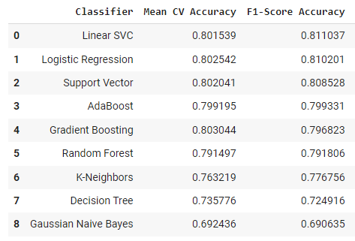
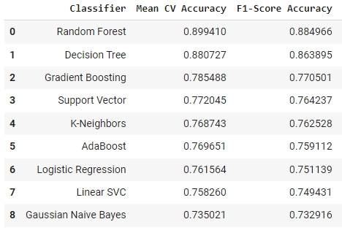
Model Training Performance : Classifiers Comparison without Optimization
Default Hyperparameters are used for each Classifier tested for both unbalanced (left) and balanced dataset (right)
Without optimization and based on the F1-score metric, the Random Forest classifier shows better results
With balanced dataset, tree-based machine learning algorithms give the best results
F1-score improvement for RF Classifier is +11.9%

Slide 15
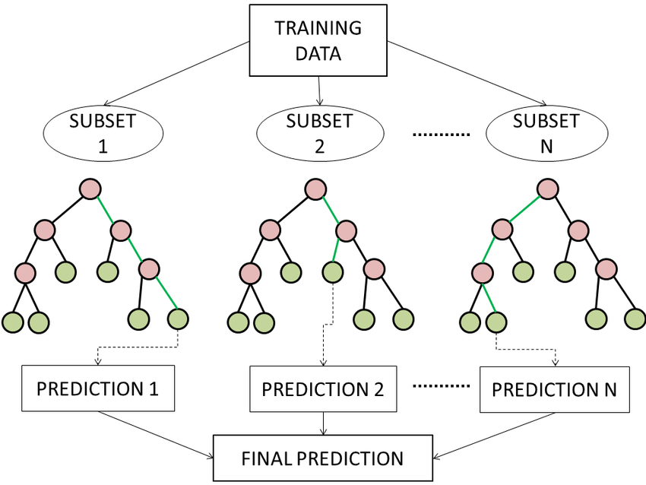
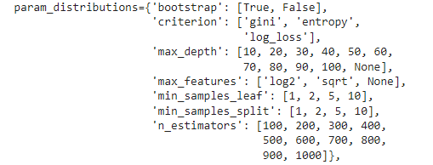
Model Training Performance : Best Classifier Optimization
RANDOM FOREST CLASSIFIER
Random Forest is a tree-based machine learning algorithm that leverages the power of multiple decision trees for making decisions. Each node in the decision tree works on a random subset of features to calculate the output. The random forest then combines the output of individual decision trees to generate the final output.
Random Search Configuration :
number of iteration = 100
cross-validation splitting strategy = StratifiedKFold (n_split: 5)
➔ Fitting 5 folds for each of 100 candidates, totalling 500 fits

Slide 16
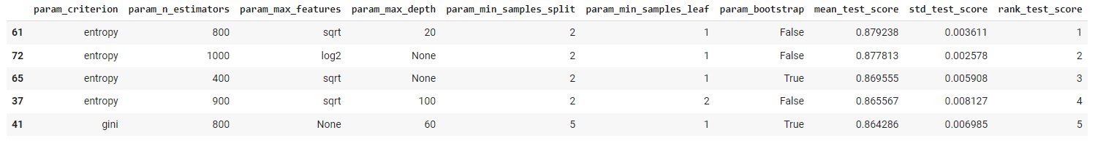
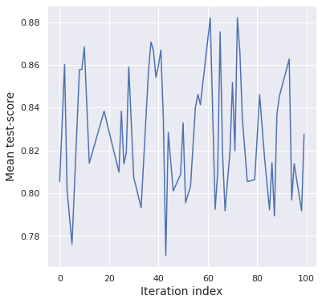
Model Training Performance : Optimization results
The mean test-score overall the iteration (n=100) varies between 0.78 and 0.88 (either 10% of variation)
The optimization of the hyperparameters lead to an improvement of 1.7% of the f1-score
F1-score metric :
Before optimization : 0.885
After optimization : 0.900
+1.7%

Slide 17
Model Training Performance : Hyperparameters tuning on the initial dataset
1
RandomizedSearchCV
Tries random combinations of a range of values (we have to define the number of iterations). It is good at testing a wide range of values and normally it reaches a very good combination very fast, but the problem that it doesn’t guarantee to give the best parameter combination because not all parameter values are tried out
2
RandomizedSearchCV results visualisation and the choix of several best values for each parametre to test them further
3
GridSearchCV
We try every combination of a present list of values of the hyper-parameters and choose the best combination based on the cross validation score.
RandomizedSearchCV

Slide 18

Model Training Performance: Hyperparameters tuning on the initial dataset
Step 1 : RandomizedSearchCV
class sklearn.ensemble.RandomForestClassifier
(n_estimators
criterion
max_depth
min_samples_split
min_samples_leaf
min_weight_fraction_leaf
max_features
max_leaf_nodes
min_impurity_decrease
bootstrap
oob_score
n_jobs
random_state
verbose
warm_start
class_weight
ccp_alpha
max_samples)
n_estimators = [int(x) for x in np.linspace(start = 1, stop = 1000, num = 10)]
max_features = ['log2', 'sqrt']
max_depth = [int(x) for x in np.linspace(start = 1, stop =15, num = 15)]
min_samples_split = [int(x) for x in np.linspace(start = 2, stop = 1000, num = 10)]
min_samples_leaf = [int(x) for x in np.linspace(start = 2, stop = 1000, num = 10)]
bootstrap = [True, False]
class_weight=[{0:1,1:1}, {0:1,1:2},{0:1,1:3},{0:1,1:4},{0:1,1:5},{0:1,1:6},{0:1,1:7},{0:1,1:8},{0:1,1:10},{0:1,1:20}]
rs =RandomizedSearchCV
(rf, param_dist,
n_iter = 100, cv = 3, verbose = 1,n_jobs=-1, random_state=0)

Slide 19
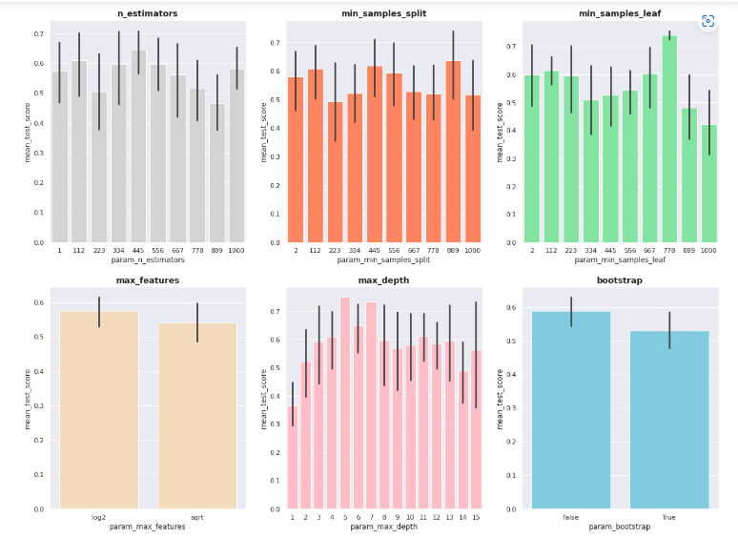
Model Training Performance: Hyperparameters tuning on the initial dataset
Step 2 : Preparation for GridSearchCV
Fitting 3 folds for each of 100 candidates, totalling 300 fits
{'n_estimators': 223, 'min_samples_split': 223, 'min_samples_leaf':
1000, 'max_features': 'log2', 'max_depth': 6,
'class_weight': {0: 1, 1: 2}, 'bootstrap': False}

Slide 20
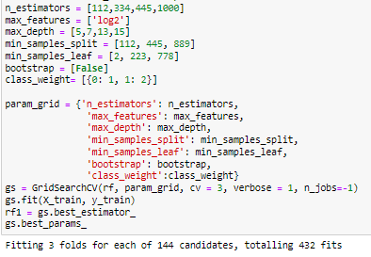
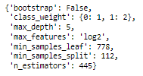
Model Training Performance: Hyperparameters tuning on the initial dataset
Step 3 : GridSearchCV

Slide 21


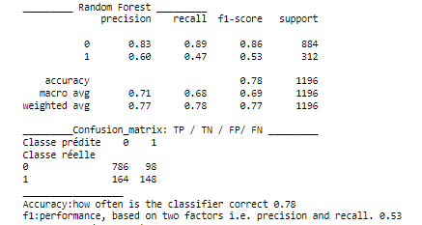
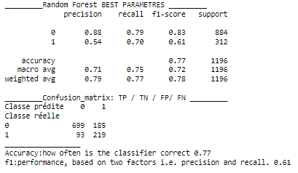
Model Training Performance: Hyperparameters tuning on the initial dataset
Results
vs

Slide 22
Model Training Performance: results and conclusions
RANDOM FOREST CLASSIFIER
Accuracy
F1 score
initial unbalanced dataset
79 %
53 %
initial unbalanced dataset parametres optimization
77 %
61%
balanced dataset
88 %
balanced dataset parametres optimization
90 %

Slide 23

QUESTIONS ?

Slide 24

Link Google Collaboratory
Version final Project CHURN .ipynb - Colaboratory (google.com)

